Slide 1

Demon Slayer (Turn-based game)
Joseph Gan SEB Project Presentation

Slide 2

Explain Project Objective
What did I create?
Turn-based game off the popular anime production “Demon Slayer: Kimetsu No Yaiba”.
Created a few attacks/types and incorporated them into a battle game.

Slide 3

Tech Stack
CSS
HTML
Javascript

Slide 4

Planning Process
Got lost on youtube / online searches

Slide 5
Planning Process
Restarted from scratch simply using learnt Javascript functions
Static Class: Character list / details
Static functions

Slide 6
Planning Process
Created basic HTML for selection screen + game screen
Created and appended elements + click events
Created the turn cycle
Trouble shoot

Slide 7

Demo / Code

Slide 8
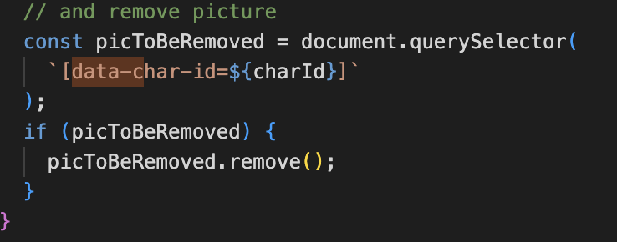
Some Code Discoveries
querySelector for a specific attribute

Slide 9
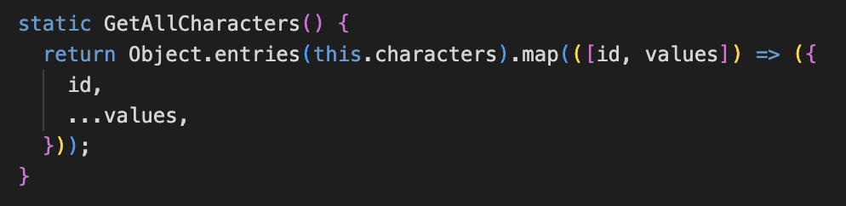
Some Code Discoveries
Object.entries() VS Object.entries().map

Slide 10
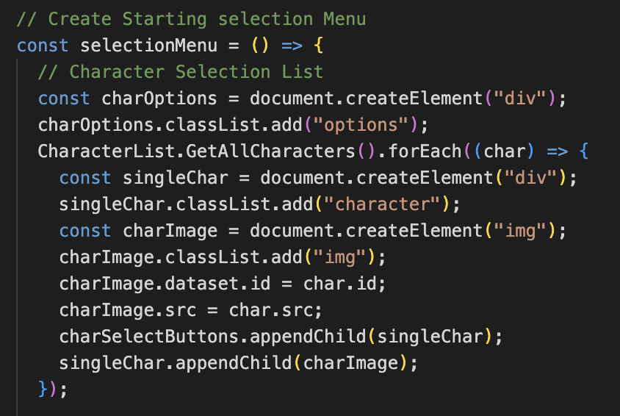
Some Code Discoveries
HTML does not need to have every component at the start

Slide 11
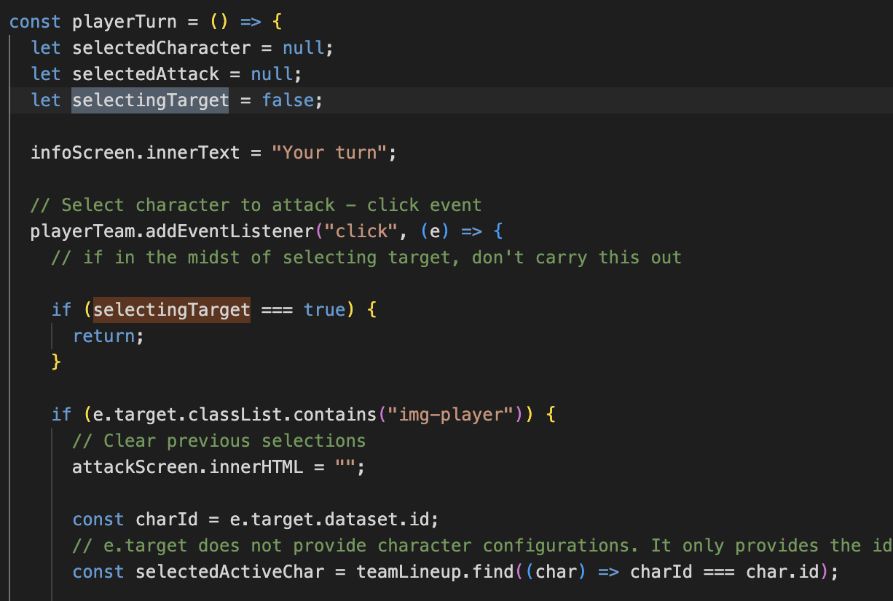
Some Code Discoveries
Using variable creations to prevent overlapping functions

Slide 12

What I learnt
Planning the game flow / overall look before starting
Writing Pseudo code is very important – easy to get lost
Problem solving – half the time spent on trouble shooting
The internet does not always give the best answers
Constantly failing = Better learning

